Slide 1
Permutations and
Combinations
ICI 1404 Mathematics & Statistics

Slide 2
Objectives:
apply fundamental counting principle
compute permutations
compute combinations
distinguish permutations vs combinations
Solve various problems

Slide 3
Fundamental Counting Principle
Fundamental Counting Principle can be used determine the number of possible outcomes when there are two or more characteristics .
Fundamental Counting Principle states that if an event has m possible outcomes and another independent event has n possible outcomes, then there are m* n possible outcomes for the two events together.

Slide 4
Fundamental Counting Principle
Lets start with a simple example.
A student is to roll a die and flip a coin. How many possible outcomes will there be?
1H 2H 3H 4H 5H 6H
1T 2T 3T 4T 5T 6T
12 outcomes
6*2 = 12 outcomes

Slide 5
Permutations
A Permutation is an arrangement of items in a particular order.
Notice, ORDER MATTERS!

Slide 6
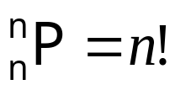
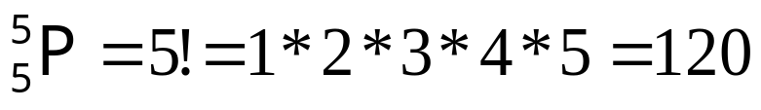
Permutations
Three cases
Case 1. Select n out of n different items (objects).
e.g. The different signals can be made chosen 5 bulbs with 5 different colours.

Slide 7
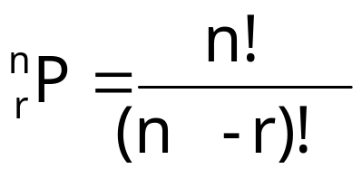
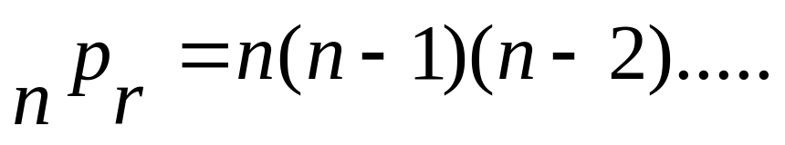

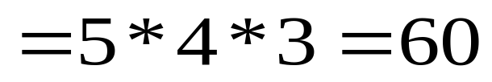
Permutations
Case 2. Select r out of n different items(objects).
where r≤n .
r terms
e.g. The different signals can be made chosen 3 bulbs with 5 different colours.
(Multiply three numbers from 5.)

Slide 8
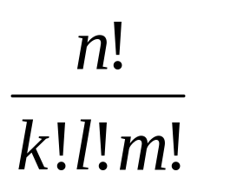
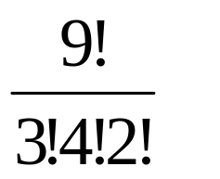
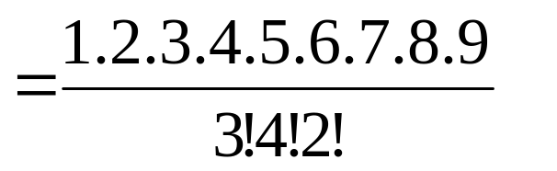
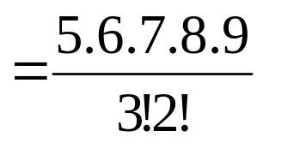

Permutations
Case 3. Select n (all) out of n but some k items are similar, another l items are similar, another m items are similar etc.…..
here n=k+l+m
Number of permutations =
e.g. The different signals can be made chosen all bulbs out of 3 red bulbs, 4 blue and 2 green.
Number of permutations =

Slide 9
Permutations
Example 1:
A combination lock will open when the right choice of three numbers (from 1 to 20, inclusive) is selected. How many different lock combinations are possible assuming no number is repeated?

Slide 10
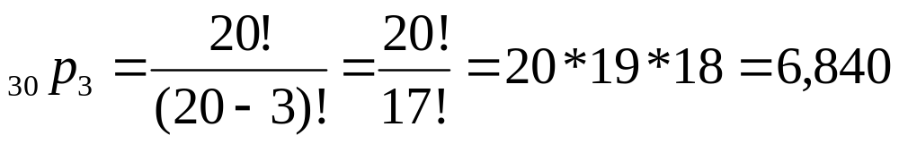
Permutations
Solution:
A combination lock will open when the right choice of three numbers (from 1 to 20, inclusive) is selected. How many different lock combinations are possible assuming no number is repeated?

Slide 11
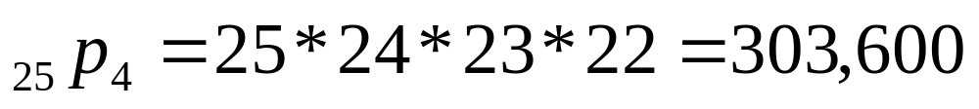
Permutations
Example 2:
From a class of 25 students, a President, Vice President, Secretary, Vice Secretary and Treasurer are to be elected. In how many ways can the officers be filled?

Slide 12
Combinations
A Combination is an arrangement of items in which order does not matter.
ORDER DOES NOT MATTER!
Since the order does not matter in combinations, there are fewer combinations than permutations. The combinations are a "subset" of the permutations.

Slide 13
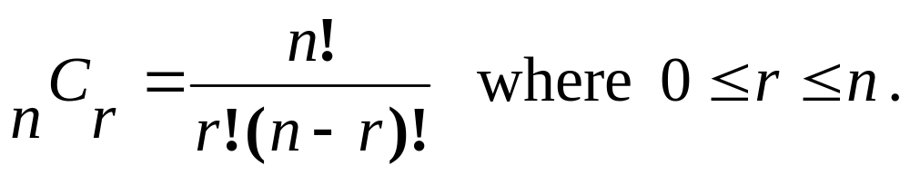
Combinations,
To find the number of Combinations of n items chosen r at a time, you can use the formula

Slide 16
Combinations
Example 1:
To play a particular card game, each player is dealt five cards from a standard deck of 52 cards. How many different hands are possible?

Slide 17
Combinations
Practice:
To play a particular card game, each player is dealt five cards from a standard deck of 52 cards. How many different hands are possible?

Slide 18
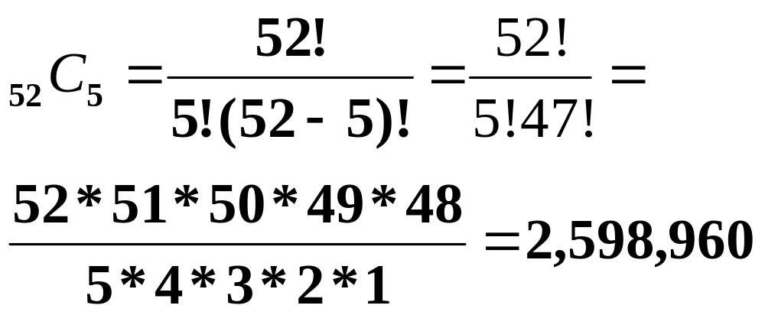
Combinations
To play a particular card game, each player is dealt five cards from a standard deck of 52 cards. How many different hands are possible?
Solution:

Slide 19
Combinations
Example 2:
A student must answer 4 out of 6 essay type questions on a test. In how many different ways can the student select the questions?

Slide 20
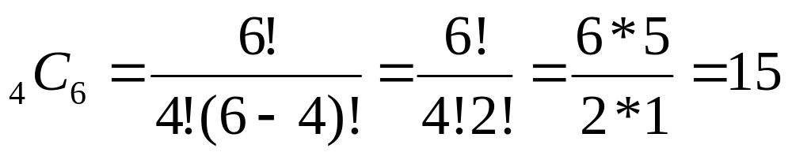
Combinations
A student must answer 4 out of 6 essay questions on a test. In how many different ways can the student select the questions?
Solution:

Slide 21
Questions
1. How many different words can be made in following cases.
(i) Selecting four letters from the word “ENGINEERING”
(ii) Selecting five letters from the word “TISSAMAHARAMAYA”
(iii) Selecting three letters from the word “KODDIKKAAMAM”

Slide 22
Questions
1. How many different words can be made in following cases.
(i) Selecting four letters from the word “ENGINEERING”
(ii) Selecting five letters from the word “TISSAMAHARAMAYA”
(iii) Selecting three letters from the word “KODDIKKAAMAM”
Solution 1(i):
E -3, N-3, G-2, I-2, R-1
Case 1: three similar letters plus one another
Case 2: two similar letters plus another two similar
Case 3: two similar letters plus another two different
Case 4: all four letters are different

Slide 23
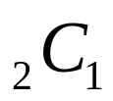
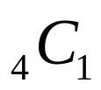
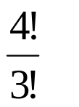
Questions
E -3, N-3, G-2, I-2, R-1
Case 1: three similar letters plus one another
three similar letters can be taken by ways = 2 ways ( E or N)
Other single letter can be taken by ways = 4 ways (
So totally 8 combinations. For each combination permutations. 4 different words . Then in this case number of 32 words can be made.

